Slide 1

Siemens Data Challenge
Analyzing the UN Greenhouse Gas Emission Dataset
Peter Stroppa

Slide 2

WHY the Greenhous Emission Dataset?
Sustainability is a KEY aspect within Digital Transformation
Greenhouse Gases
Digital Transformation
New challenge
Bearings
Bearings interesting for Industry
thorough analysis complex
Airbnb
no Digital Transformation focus
Have done regression on similar data already

Slide 3
Use Case – Emission Data
Questions:
UN regularly implements new climate rules → Execution by countries?
  Which country reduces its carbon footprint / which does not?
  Which countries can reach a specific climate goal?
Approach:
Analysis: Thouroughly analyze data – understand the dataset
Predition: Try to predict future emission values

Slide 4
Setup:
Implemented in Python 3.10
Virtual Python environment for clear package handling
Requirements.txt creation for easy recreatability
IDE: Visual Studio Code

Slide 5
Data Analysis
Understanding your data is key for further processing (f.e ML)
  Analysis of CO2, CH4, SF6
  Which country made the biggest improvement?
  Which country had the year with the most/least emissions?
  Which country emitted mosted over the whole period?

Slide 6
Results: biggest reduction in Emission
Measure: Max/current_value
(Data from: 1990 – 2014)
Lithunia reduced its C02 emissions by 298%
Lithunia reduced its CH4 emissions by 298%
Norway reduced its SF6 emissions by 3800%

Slide 7
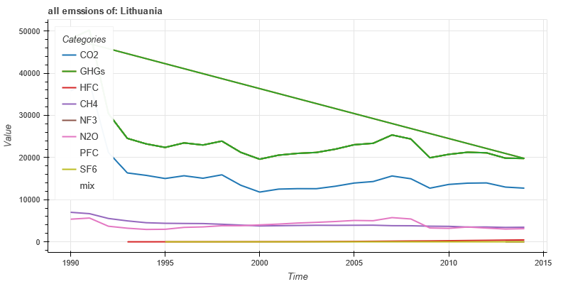
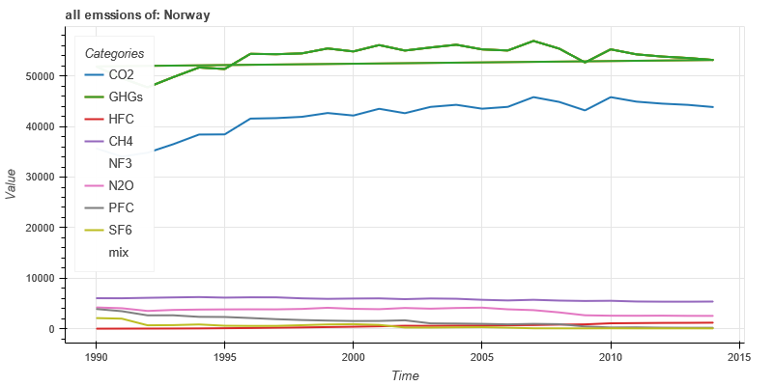
Results: biggest reduction in Emission
Measure: Max/current_value
(Data from: 1990 – 2014)
Lithunia
Norway
(Emissions in kilo-tonns)
Lithunia :C02 - 298%, Lithuania: CH4 – 298% Norway: SF6 – 3800%

Slide 8
Results: years with highest emission
Measure: Max
(Data from: 1990 – 2014)
In 2005 USA emitted over 6 billion tons of CO2
In 1990 Russia emitted over 900 million tons of CH4
In 1990 USA emitted over 30 million tons of SF6

Slide 9
Results: years with highest emission
Measure: Max
(Data from: 1990 – 2014)
USA
Russia
(Emissions in kilo-tonns)
USA :C02 6 billion tons Russia: SF6 30 mio tons
Notes:
Lowest emission:
CO2:Monaco:71,9 CH4:Monaco:0.8 SF6:Liechtenstein:0.1
CO2:Monaco:74,4 CH4:Monaco:0.9 SF6:Liechtenstein:0.1
CO2:Monaco:75,2 CH4:Monaco:1 SF6:Liechtenstein:0.1

Slide 10
Results: maximal total C02 emissions
Measure: sum(emissions)
(Data from: 1990 – 2014)
USA emitted over 141 billion tons of CO2
Russia emitted over 18 billion tons of CH4
USA emitted over 400 million tons of SF6

Slide 11
Analysis summary:
  Analysis of CO2, CH4, SF6
  Which country made the biggest improvement?
  Which country had the year with the most/least emissions?
  Which country emitted mosted over the whole period?
  Which country could reach a specific emission goal in the next years?

Slide 12
Data Prediction - Prototype:
First Approach:
Use regression prediction
  Package: Skforecast
Random Forest regression / Recursive Regressor
Backtracking & fixed steps, Gridforecaster
NOTHING WORKED SUFFICIENTLY
Second Approach:
Before Regression parabolic interpolation of data
  Package: statsmodels
SARIMAX Regressor
Worked but would need further feature and hyper-parameter treatment

Slide 13
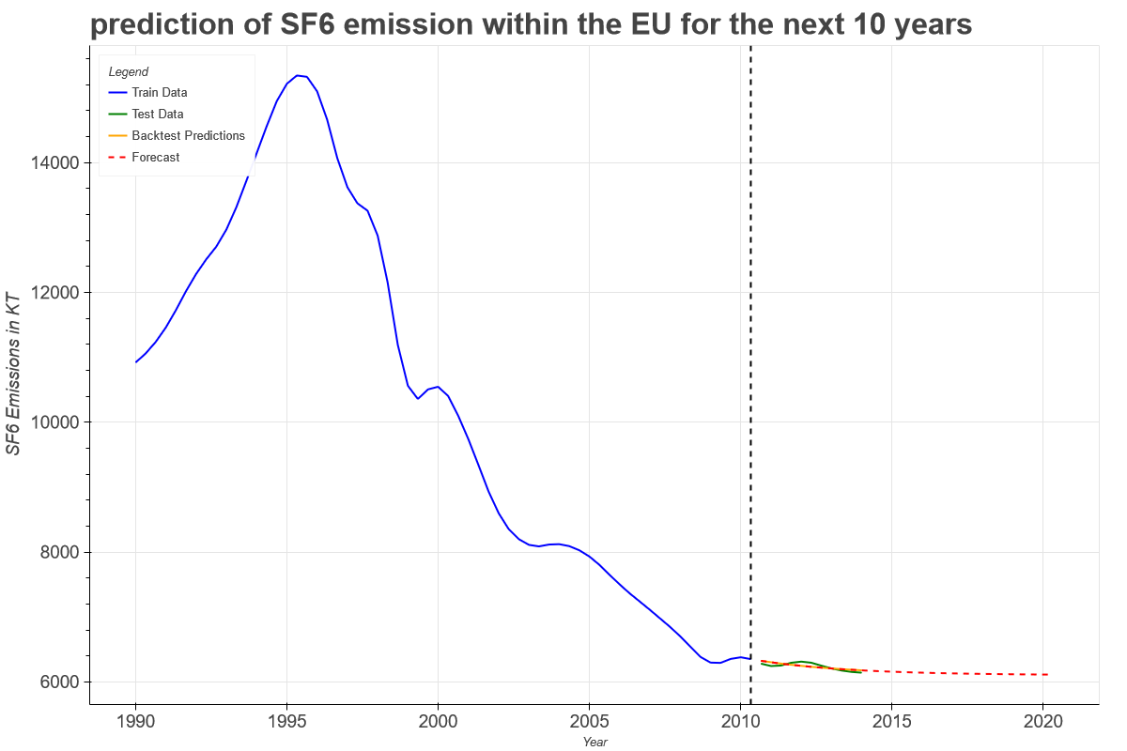
Results Data Prediction - Prototype: now it would be possible to check emission goals!
SF6 Emission of European Union
Data between 1990 - 2014
Interpolate ever 2nd & 3rd value
Train / test split = 85/15
SARIMAX model

